Slide 1
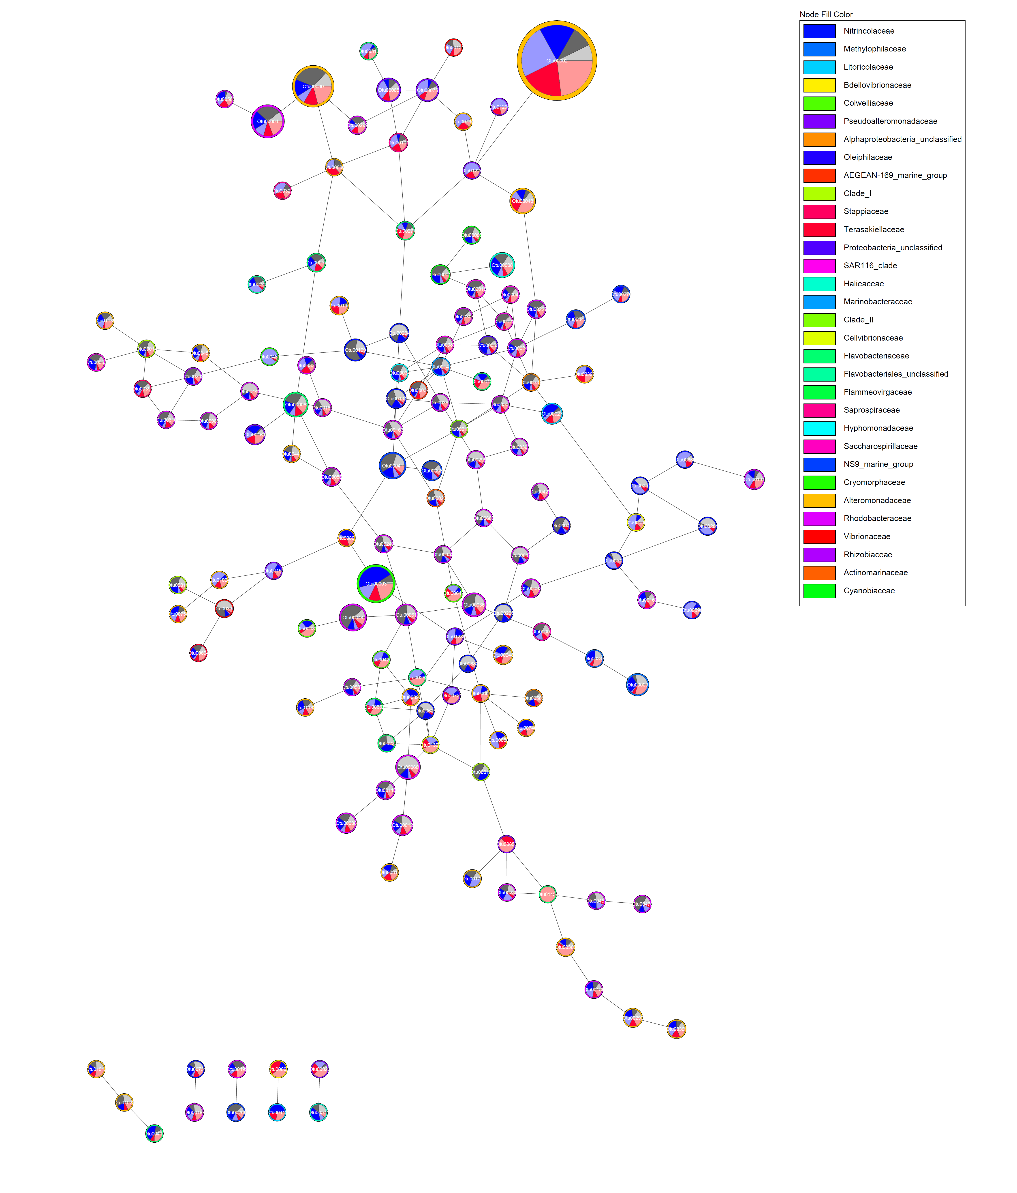
Border: Family
Fill: Treatment
Negative Control
Negative Control + Heated
Non-bleached + Ambient
Beached + Ambient
Non-bleached + Heated
Bleached + Heated

